Slide 1
Data Structure & Algorithms
Recursion

Slide 2
Recursion
Recursion is a programming technique in which a method (function) calls itself.
Very effective technique in programming
Used to solve a wide class of problems
Factorials.
Fibonacci.
Binary Search.
Towers of Hanoi.
Mergesort.

Slide 3
Key with Recursion
Separate the problem into:
A base case which you know to be true.
A recursive step, which represents the answer to a larger problem in terms of a smaller one
Idea, the recursive step will get you closer to the base case.
Let’s solve Factorial(n) in this way :
factorial (1) = 1
factorial(2) = 1*2
factorial(3) = 1*2*3=6
factorial(4) = 1*2*3*4=24

Slide 4
Factorial Numbers and Recursion
Note:
factorial (1) = 1
factorial(2) = 2
factorial(3) = 6
factorial(4) = 24
We can note that, in general:
factorial(n) = n * factorial (n-1)
This can be our recursive step
Which will carry us to the base case:
factorial(1) = 1
This cannot be broken down any further

Slide 5
Factorials
Factorial of n is found by multiplying n by the factorial of n-1.
factorial(n)= n*factorial(n-1)
The factorial of 0 is defined to be 1.
A recursive method:
int factorial(int n)
{
if(n==0)
return 1;
else
return (n * factorial(n-1) );
}

Slide 6
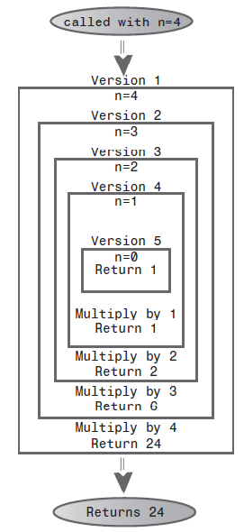
Factorials
Factorial(4).

Slide 7
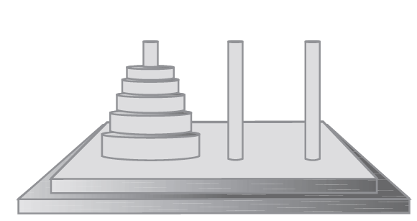
The Towers of Hanoi
The Towers of Hanoi is an ancient puzzle consisting of a number of disks placed on three columns,
A B C
The object of the puzzle is to transfer all disks from A to C
Can only move one at a time
Cannot place a disk on one that’s smaller
Note: This algorithm is EXPENSIVE for large # of disks

Slide 8
The Towers of Hanoi (Cont’d)
Here’s the algorithm:
1. Move the subtree consisting of the top n-1 disks from A to B.
2. Move the remaining (largest) disk from A to C.
3. Move the subtree from B to C.

Slide 9
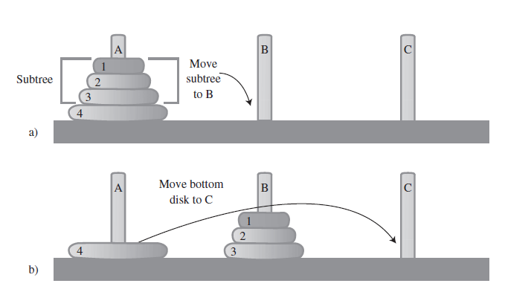
The Towers of Hanoi (Cont’d)
First, the subtree consisting of disks 1, 2, and 3 is moved to the intermediate tower B.
Then the largest disk, 4, is moved to tower C.

Slide 10
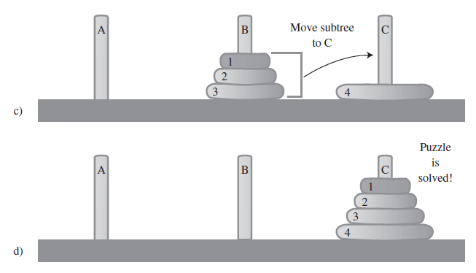
The Towers of Hanoi (Cont’d)
Then the subtree is moved from B to C.

Slide 11
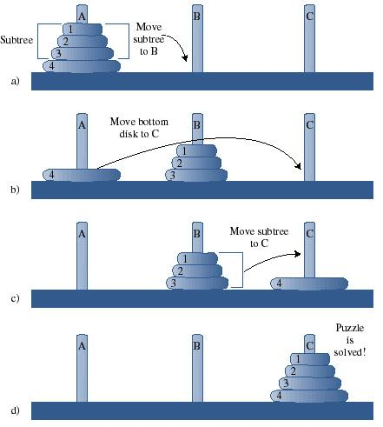
Of course..
We broke a rule, can’t move multiple disks
But, moving top three to (B) is a smaller problem:
Move the top two to (C)
Move the third to (B)
Move the other two from (C) to (B)
Similar for moving top two to (C)
1 disk = base case

Slide 12
Recursion and Stacks
There is a close relationship between recursion and stacks. In fact, most compilers implement recursion by using stacks.
As we noted, when a method is called, the compiler pushes the arguments to the method and the return address (where control will go when the method returns) on the stack, and then ransfers control to themethod. When the method returns, it pops these values off the stack.
The arguments disappear, and control returns to the return address.

Slide 13
Data Structure & Algorithms
Abstract Data Type

Slide 14
Abstract Data Type (ADT)
What is an ADT?
Roughly speaking, it’s a way of looking at a data structure: focusing on what it does and ignoring how it does its job.
Stacks and queues are examples of ADTs.

Slide 15
A Stack Implemented by a Linked List
When we created a stack in we used an ordinary Java array to hold the stack’s data.
actually carried out by array operations such as
arr[++top] = data;
and
data = arr[top--];
which insert data into, and take it out of, an array.
can also use a linked list to hold a stack’s data:
In this case the push() and pop() operations would be carried out by operations like:
theList.insertFirst(data)
and
data = theList.deleteFirst()

Slide 16
// linkStack.java
// demonstrates a stack implemented as a list
// to run this program: C>java LinkStackApp
////////////////////////////////////////////////////////////////
class Link
{
public long dData; // data item
public Link next; // next link in list
Abstract Data Types 203
// -------------------------------------------------------------
public Link(long dd) // constructor
{ dData = dd; }
// -------------------------------------------------------------
public void displayLink() // display ourself
{ System.out.print(dData + “ “); }
} // end class Link
////////////////////////////////////////////////////////////////
class LinkList
{
private Link first; // ref to first item on list
// -------------------------------------------------------------
public LinkList() // constructor
{ first = null; } // no items on list yet
// -------------------------------------------------------------
public boolean isEmpty() // true if list is empty
{ return (first==null); }
// -------------------------------------------------------------
public void insertFirst(long dd) // insert at start of list
{ // make new link
Link newLink = new Link(dd);
newLink.next = first; // newLink --> old first
first = newLink; // first --> newLink
}
// -------------------------------------------------------------
public long deleteFirst() // delete first item
{ // (assumes list not empty)
Link temp = first; // save reference to link
first = first.next; // delete it: first-->old next
return temp.dData; // return deleted link
}
// -------------------------------------------------------------
public void displayList()
{
Link current = first; // start at beginning of list
while(current != null) // until end of list,
{
current.displayLink(); // print data
current = current.next; // move to next link
}
System.out.println(“”);

Slide 17
}} // end class LinkList
class LinkStack
{
private LinkList theList;
public LinkStack() // constructor
{
theList = new LinkList();
} public void push(long j) // put item on top of stack
{theList.insertFirst(j);}
public long pop() // take item from top of stack
{
return theList.deleteFirst();
} public boolean isEmpty() // true if stack is empty
{
return ( theList.isEmpty() );
}
public void displayStack()
{System.out.print(“Stack (top-->bottom): “);
theList.displayList();}
} // end class LinkStack
class LinkStackApp
{
public static void main(String[] args)
{
LinkStack theStack = new LinkStack(); // make stack
Abstract Data Types 205
LISTING 5.4 Continued
theStack.push(20); // push items
theStack.push(40);
theStack.displayStack(); // display stack
theStack.push(60); // push items
theStack.push(80);
theStack.displayStack(); // display stack
theStack.pop(); // pop items
theStack.pop();
theStack.displayStack(); // display stack
} // end main()
} // end class LinkStackApp

Slide 18
A Queue Implemented by a Linked List
class Link
{
public long dData; // data item
public Link next; // next link in list
// -------------------------------------------------------------
public Link(long d) // constructor
{ dData = d; }
// -------------------------------------------------------------
public void displayLink() // display this link
{ System.out.print(dData + “ “); }
// -------------------------------------------------------------
} // end class Link
////////////////////////////////////////////////////////////////
class FirstLastList
{
private Link first; // ref to first item
private Link last; // ref to last item
// -------------------------------------------------------------

Slide 19
public FirstLastList() // constructor
{
first = null; // no items on list yet
last = null;
}
// -------------------------------------------------------------
public boolean isEmpty() // true if no links
{ return first==null; }
// -------------------------------------------------------------
public void insertLast(long dd) // insert at end of list
{
Link newLink = new Link(dd); // make new link
if( isEmpty() ) // if empty list,
first = newLink; // first --> newLink
else
last.next = newLink; // old last --> newLink
last = newLink; // newLink <-- last
}

Slide 20
public long deleteFirst() // delete first link
{ // (assumes non-empty list)
long temp = first.dData;
if(first.next == null) // if only one item
last = null; // null <-- last
first = first.next; // first --> old next
return temp;
}
// -------------------------------------------------------------
public void displayList()
{
Link current = first; // start at beginning
while(current != null) // until end of list,
{
current.displayLink(); // print data
current = current.next; // move to next link
}
System.out.println(“”);

Slide 21
}} // end class FirstLastList
class LinkQueue
{
private FirstLastList theList;
//--------------------------------------------------------------
public LinkQueue() // constructor
{ theList = new FirstLastList(); } // make a 2-ended list
//--------------------------------------------------------------
public boolean isEmpty() // true if queue is empty
{ return theList.isEmpty(); }
//--------------------------------------------------------------
public void insert(long j) // insert, rear of queue
{ theList.insertLast(j); }
//--------------------------------------------------------------
public long remove() // remove, front of queue
{ return theList.deleteFirst(); }
{
System.out.print(“Queue (front-->rear): “);

Slide 22
theList.displayList();
}
//--------------------------------------------------------------
} // end class LinkQueue
////////////////////////////////////////////////////////////////
class LinkQueueApp
{
public static void main(String[] args)
{
LinkQueue theQueue = new LinkQueue();
theQueue.insert(20); // insert items
theQueue.insert(40);
theQueue.displayQueue(); // display queue
theQueue.insert(60); // insert items
theQueue.insert(80);
theQueue.displayQueue(); // display queue
theQueue.remove(); // remove items
theQueue.remove();
theQueue.displayQueue(); // display queue
} // end main()

Slide 23
Data Types and Abstraction
Where does the term Abstract Data Type come from? Let’s look at the data type part of it first and then return to abstract.
Data Types: The phrase data type covers a lot of ground. It was first applied to built-in types such as int and double.
IN object-oriented programming, you could now create your own data types using classes.
The phrase data type seems to fit naturally with such quantity-oriented classes. However, it is also applied to classes that don’t have this quantitative aspect. In fact, any class represents a data type, in the sense that a class is made up of data (fields) and permissible operations on that data (methods).

Slide 24
Abstraction
The word abstract means “considered apart from detailed specifications or implementation.”
An abstraction is the essence or important characteristics of something. The office of president, for example, is an abstraction, considered apart from the individual who happens to occupy that office. The powers and responsibilities of the office remain the same, while individual office-holders come and go.
In object-oriented programming, then, an Abstract Data Type is a class considered without regard to its implementation. It’s a description of the data in the class (fields), a list of operations (methods) that can be carried out on that data, and instructions on how to use these operations.

Slide 25
For the stack, the user knows that push() and pop() (and perhaps a few other methods) exist and how they work. The user doesn’t (at least not usually) need to know how push() and pop() work, or whether data is stored in an array, a linked list, or some other data structure like a tree.
The Interface:
An ADT specification is often called an interface. It’s what the class user sees—usually its public methods. In a stack class, push() and pop() and similar methods form the interface.

